Slide 1

Predictive Analytics in Business (BUAN 448)
BUAN 488 – Fall 2022 – Dr. Davoodi

Slide 2
Introduction to Logistic Regression

Slide 3
Logistic Regression
Extends idea of linear regression to situation where outcome variable, Y, is categorical
For example, Y represents a recommendation on holding/selling/buying a stock
(Each of the stocks in the dataset belongs to one of the three classes: the hold class, the sell class, and the buy class)

Slide 4
Logistic Regression
Classification: the class of a new record is unknown; predicting the new record into one of the classes based on the values of its predictor variables
Profiling: the class is known; finding factors that differentiate between classes, in terms of their predictor variables, or “predictor profile” (called profiling).

Slide 5
Classification? Profiling?
Classifying customers as returning or non-returning (classification)
Finding factors that differentiate male and female top executives (profiling)
Predicting the approval or disapproval of a loan based on information such as credit scores (classification)

Slide 6
Logistic Regression
We focus on binary classification
The outcome variable only has two possible classes:
Success/failure, yes/no, buy/don’t buy, survive/die… (i.e., Y=1 or Y=0)
Like linear regression, the predictor variables X₁, X₂, . . . , X_{k} may be
categorical variables,
continuous variables, or
a mixture of these two types.

Slide 7
Logistic Regression
Linear Regression: The aim is to predict the value of the continuous Y for a new record,
Logistic Regression: the goal is to predict which class a new record will belong to, or simply to classify the record into one of the classes

Slide 8
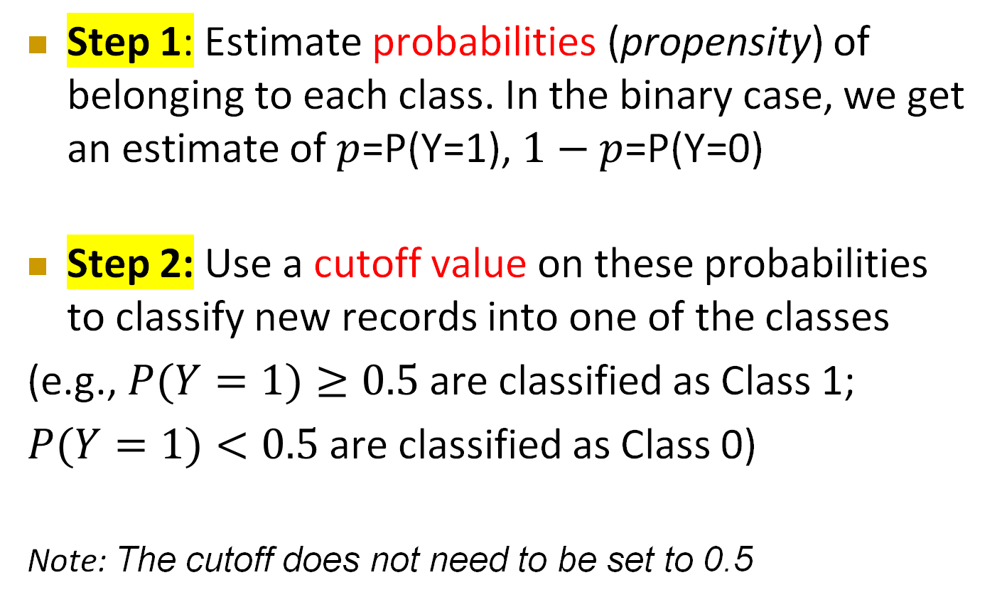
Logistic Regression
Step 1: Estimate probabilities (propensity) of belonging to each class. In the binary case, we get an estimate of $p$=P(Y=1), $1−p$=P(Y=0)
Step 2: Use a cutoff value on these probabilities to classify new records into one of the classes
(e.g., $P(Y=1)≥0.5$ are classified as Class 1;
$P(Y=1)<0.5$ are classified as Class 0)
Note: The cutoff does not need to be set to 0.5

Slide 9
The Logistic Regression Model

Slide 10
The Logit
Goal: Find a function of the predictor variables that relates them to a 0/1 outcome
Instead of using Y as outcome variable (like in linear regression), we use a function of Y called the logit
Logit can be modeled as a linear function of the predictors
Once the logit has been predicted, it can be mapped back to a probability, which, in turn, can be mapped to a class

Slide 11
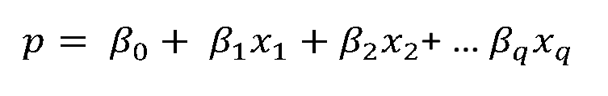
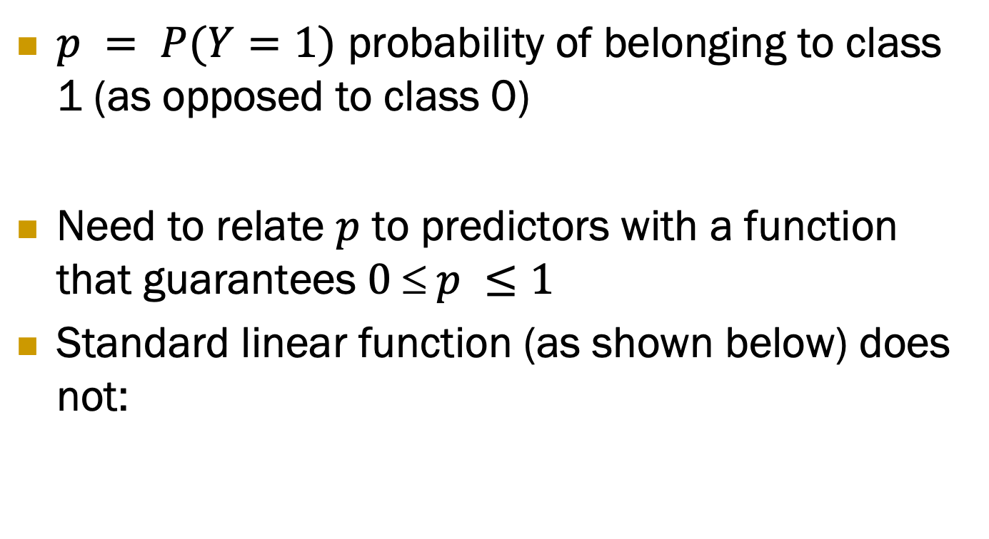
Step 1: Logistic Response Function
$p = P(Y=1)$ probability of belonging to class 1 (as opposed to class 0)
Need to relate $p$ to predictors with a function that guarantees $0  p ≤1$
Standard linear function (as shown below) does not:
q = number of predictors

Slide 12
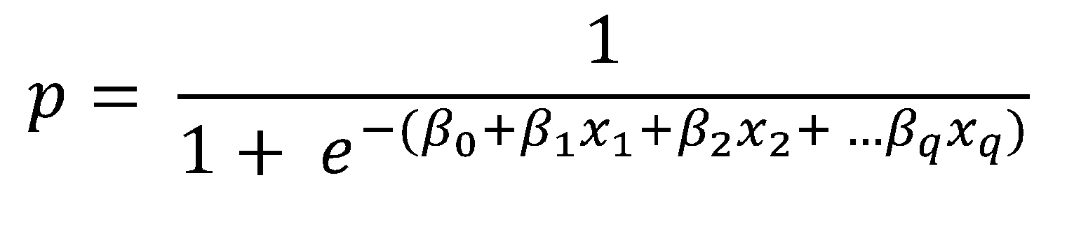
Step 1: Logistic Response Function
The Fix: use logistic response function
For any values x₁, x₂, …, x_{q}, the right-hand side will always lead to values in the interval [0,1]
Can you prove it?

Slide 13
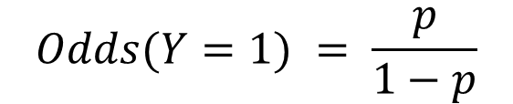
Step 2: The Odds
The odds of belonging to class 1 are defined as:
the ratio of the probability of belonging to class 1 to the probability of belonging to class 0
Odds:
Measure of belonging to a certain class;
It’s popular in horse races, sports, gambling …
$$Odds(Y=1) = \frac{p}{1−p}$$

Slide 14
Step 2: The Odds
Given the odds of an event, the probability of the event can be computed by:
Can you prove it?

Slide 15
Step 2: The Odds
Now we can relate the Odds to the predictors:
Can you prove it?

Slide 16
Interpretation
Such a relationship is interpretable in terms of percentages
A unit increase in predictor X_{j} is associated with an average increase of ꞵ_{j} * 100% in the odds (holding all the other predictors constant)

Slide 17
Step 3: Take log on both sides
The Standard formulation of a logistic model, also called the logit
The log(odds), called the logit, takes values from −∞ (very low odds) to +∞ (very high odds)
A logit of 0 corresponds to odds of 1 (probability = 0.5).
the logit models it as a linear function of the q predictors.

Slide 18
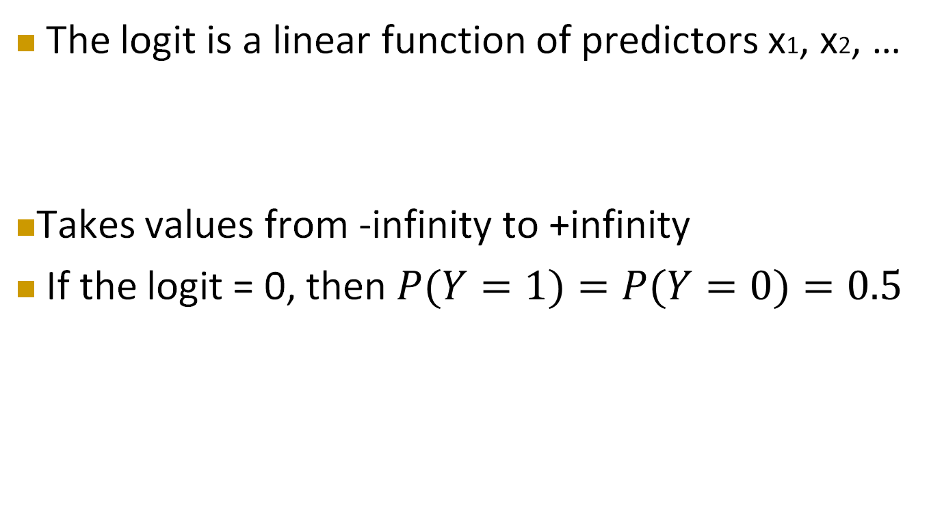
Logit, cont.
The logit is a linear function of predictors x1, x2, …
Takes values from -infinity to +infinity
If the logit = 0, then $P(Y=1)=P(Y=0)=0.5$
Can you prove it?

Slide 19
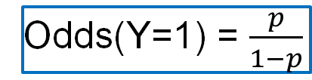
Summary
p: the probability of belonging to class 1
Odds(Y=1) = $\frac{p}{1−p}$
logistic response function
The odds
The Standard formulation of a logistic model, also called the logit

Slide 20
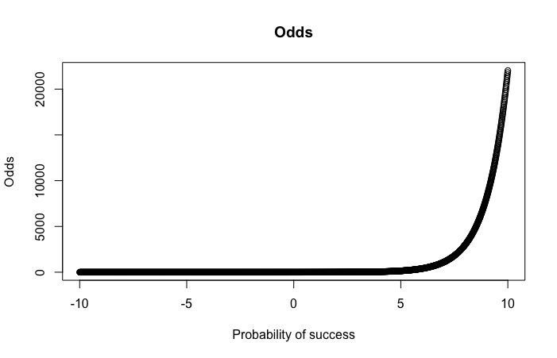
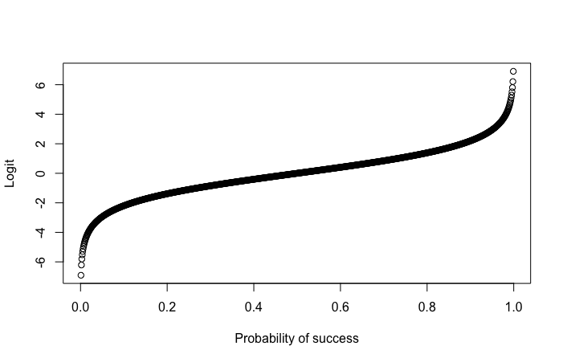
Odds (a) and Logit (b) as function of p

Slide 21
Example

Slide 22
Personal Loan Offer
The Universal Bank dataset includes data on 5,000 customers.
The data include the customer’s response to the last personal loan campaign (Personal Loan), as well as customer demographic information (Age, Income, etc.), and the customer’s relationship with the bank (mortgage, securities account, etc.).
Goal: build a model that identifies customers who are mostly likely to accept the loan offer in future mailing
Q: If you were the analyst, what model would you use? What’s the next step?

Slide 23
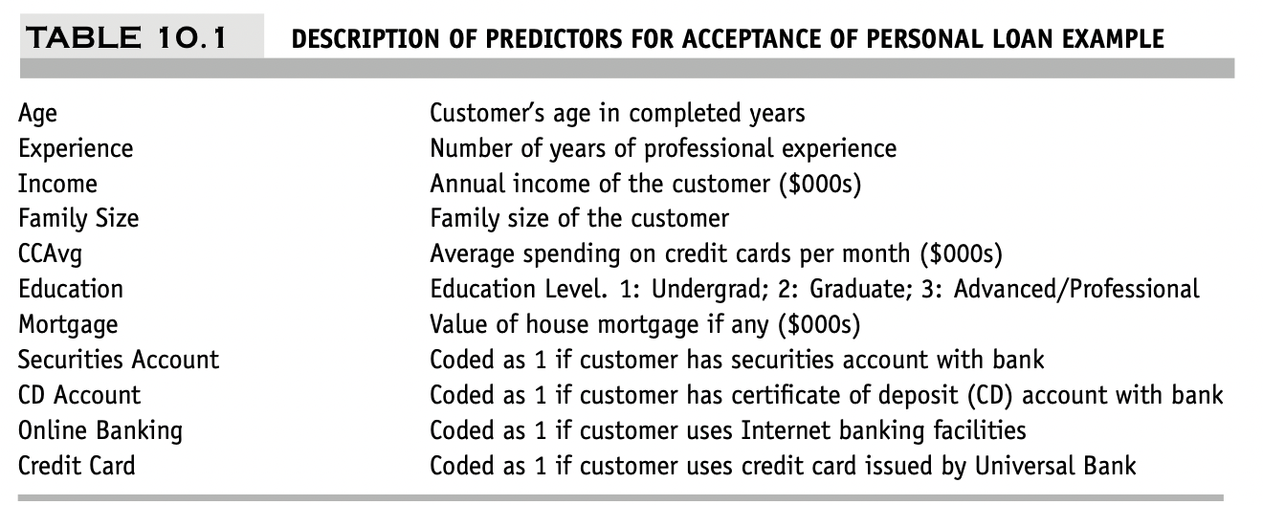
Personal Loan Offer
Outcome variable: accept bank loan (0/1)
Predictors: Demographic info, and info about their bank relationship

Slide 24
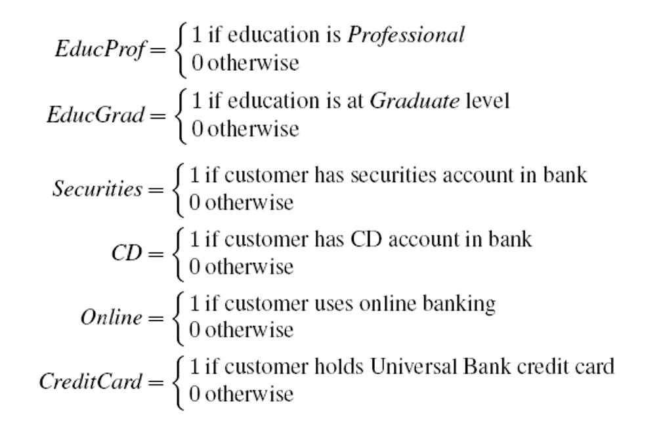
Data preprocessing
Drop “ID” and “Zip code” (why?)
Create 0/1 dummy variables for categorical predictors
Partition 60% training, 40% validation

Slide 25
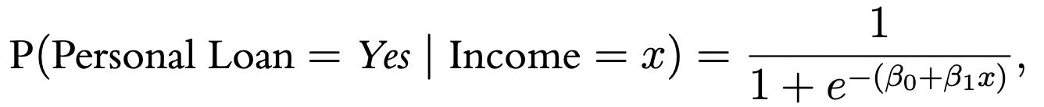
Single Predictor Model
Modeling loan acceptance on income (x)
The equation relating the outcome variable to the predictor in terms of probabilities is:
Or equivalently, in terms of odds:
$$Odds\left(Personal Loan=Yes \right|Income=x)= e^{ꞵ0+ ꞵ1 X}$$

Slide 26
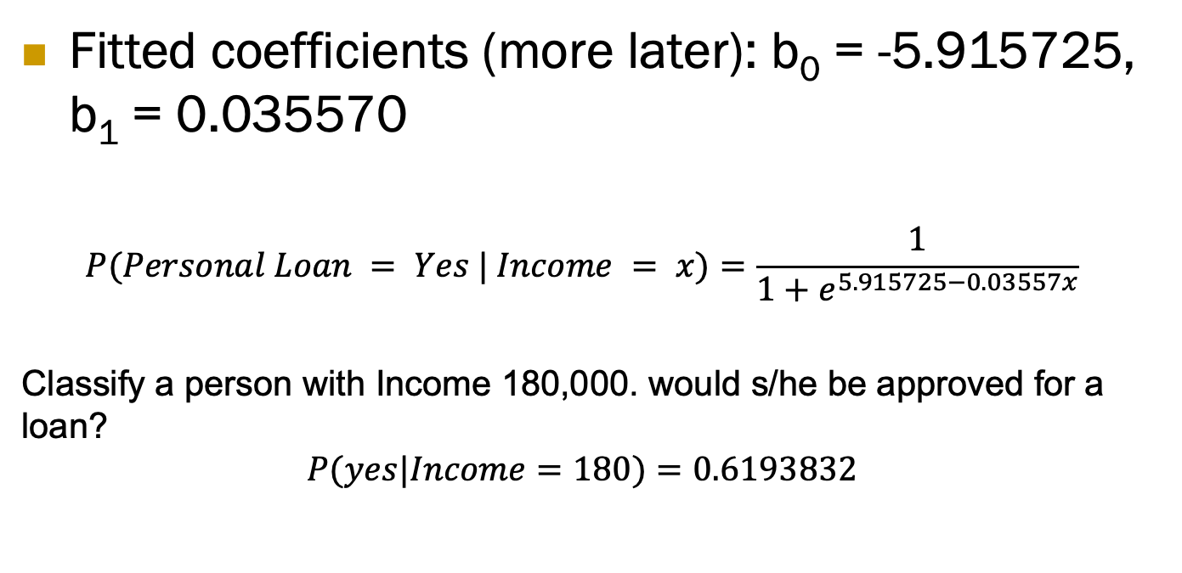
Single Predictor Model
Fitted coefficients (more later): b₀ = -5.915725, b₁ = 0.035570
$$P(Personal Loan = Yes | Income = x)=\frac{1}{1+e^{5.915725−0.03557x}}$$
Classify a person with Income 180,000. would s/he be approved for a loan?
$$P(yes|Income=180)=0.6193832$$

Slide 27
Estimating the Logistic Model from Data:
Computing Parameter Estimates

Slide 28
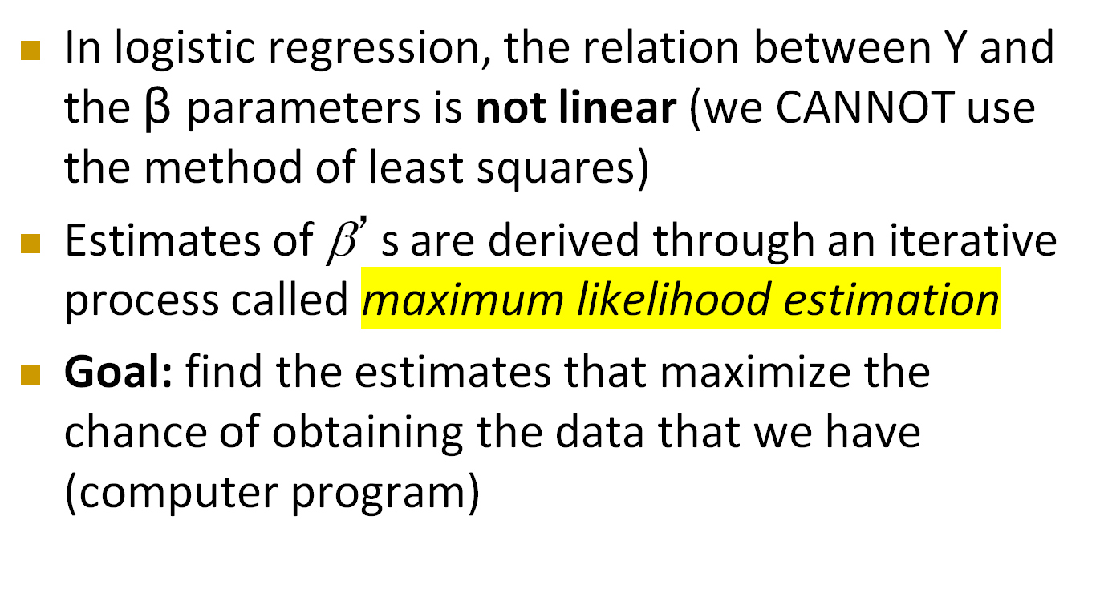
How to compute ꞵ?
In logistic regression, the relation between Y and the $ꞵ$ parameters is not linear (we CANNOT use the method of least squares)
Estimates of β’s are derived through an iterative process called maximum likelihood estimation
Goal: find the estimates that maximize the chance of obtaining the data that we have (computer program)

Slide 29
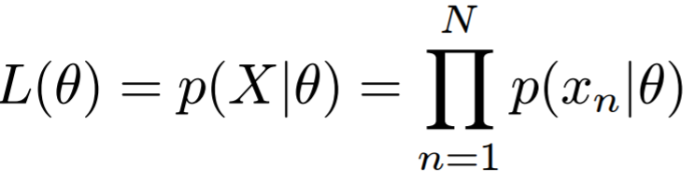
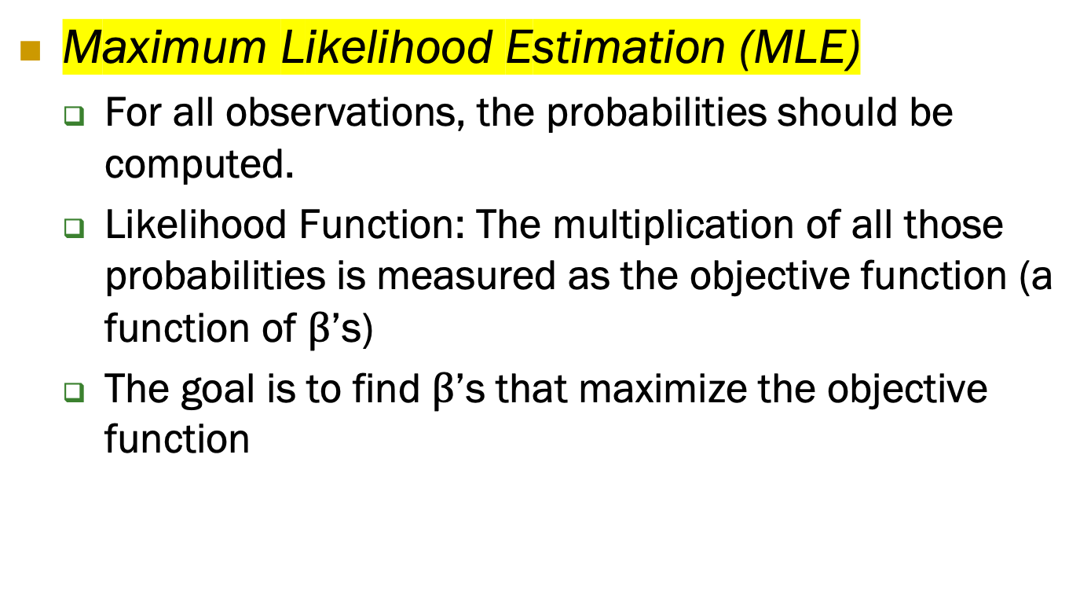
How to compute ꞵ?
Maximum Likelihood Estimation (MLE)
For all observations, the probabilities should be computed.
Likelihood Function: The multiplication of all those probabilities is measured as the objective function (a function of $β$’s)
The goal is to find $β$’s that maximize the objective function

Slide 30
Estimate ꞵ
Computed estimates are generally reliable for:
Well-behaved datasets where the number of records with outcome variable values of both 0 and 1 are large
(e.g., their ratio is “not too close” to either 0 or 1)
When the number of coefficients in the model is small relative to the sample size (e.g., no more than 10%)

Slide 31
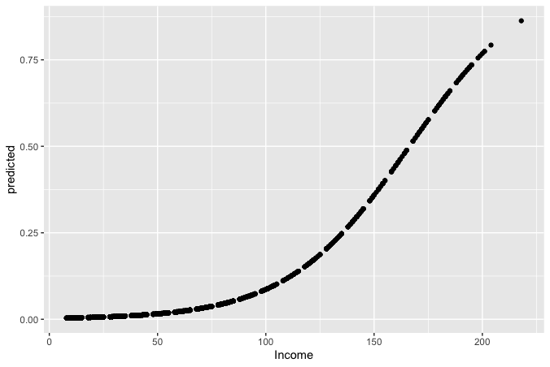

Seeing the Relationship
$$P(Personal Loan = Yes | Income = x)=\frac{1}{1+e^{5.915725−0.03557x}}$$
The predicted probabilities by the logistic regression model yields values between 0 and 1
How can we use these probabilities to predict classification?
Notes:
31

Slide 32
Last step - classify
Model produces an estimated probability of being a “Class 1”
Convert to a classification by establishing cutoff level
If estimated prob. > cutoff, classify as “Class 1”

Slide 33
Ways to Determine Cutoff
0.50 is popular initial choice
Additional considerations
Maximize classification accuracy
Minimize expected cost of misclassification (need to specify costs)

Slide 34
Example, cont.
Estimates of β’s are derived through an iterative process called maximum likelihood estimation
Let’s include all 12 predictors in the model now
Pre-processing: The education variable is an integer; it should be categorical.
Educational variable becomes two variables
In R use function glm (for general linear model) and family = “binomial”
Notes:
34

Slide 35
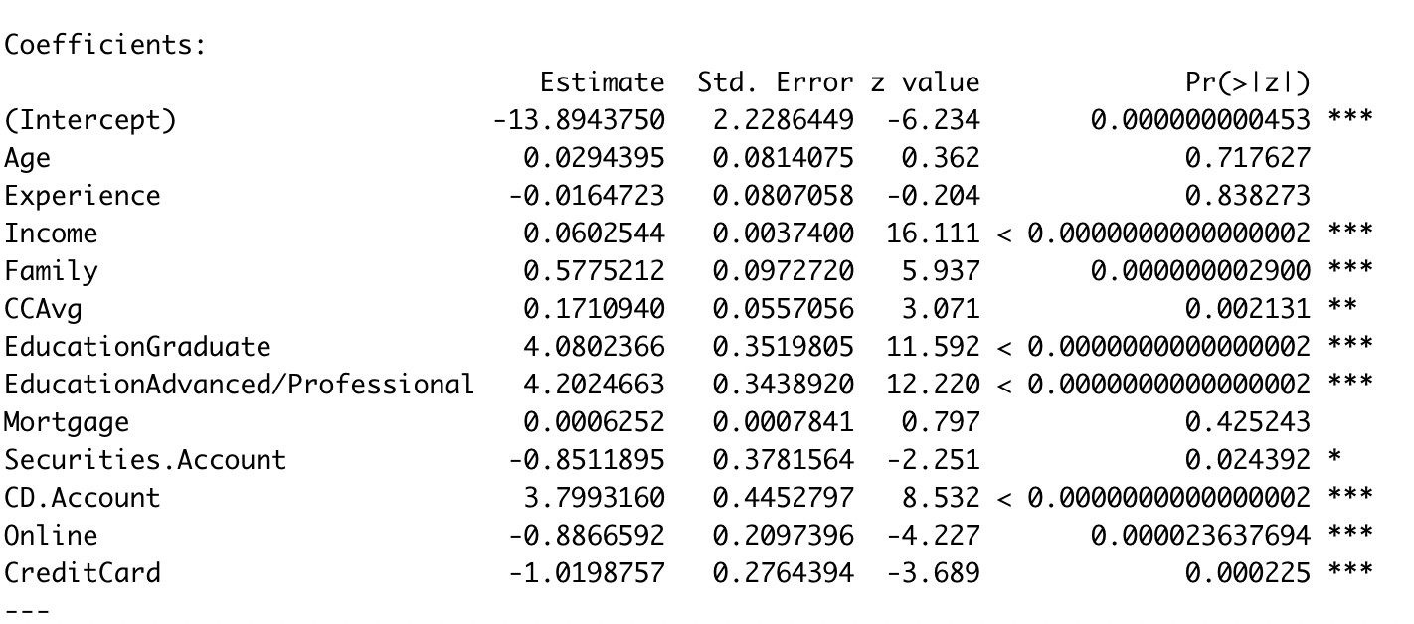
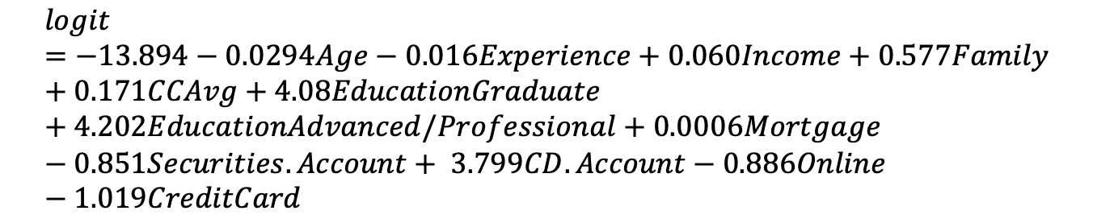
Example, cont.
$$logit=−13.894−0.0294Age−0.016Experience+0.060Income+0.577Family+0.171CCAvg+4.08EducationGraduate+4.202EducationAdvanced/Professional+0.0006Mortgage−0.851Securities.Account+ 3.799CD.Account−0.886Online−1.019CreditCard$$

Slide 36
Example, cont.
Dummy variables with positive coefficients:
Holding a CD account and having graduate or professional education (all marked by 1 in the dummy variables) are associated with higher probabilities of accepting the loan offer.
Dummy variables with negative coefficients:
Having a securities account, using online banking, and owning a Universal Bank credit card are associated with lower acceptance rates.
$$logit=−13.894−0.0294Age−0.016Experience+0.060Income+0.577Family+0.171CCAvg+4.08EducationGraduate+4.202EducationAdvanced/Professional+0.0006Mortgage−0.851Securities.Account+ 3.799CD.Account−0.886Online−1.019CreditCard$$

Slide 37
Example, cont.
Continuous variables with positive coefficients:
A higher value on that predictor is associated with a higher probability of accepting the loan offer (e.g., Income: higher-income customers tend more to accept the offer)
Continuous variables with negative coefficients:
A higher value on that predictor is associated with a lower probability of accepting the loan offer (e.g., Age: older customers are less likely to accept the offer)
$$logit=−13.894−0.0294Age−0.016Experience+0.060Income+0.577Family+0.171CCAvg+4.08EducationGraduate+4.202EducationAdvanced/Professional+0.0006Mortgage−0.851Securities.Account+ 3.799CD.Account−0.886Online−1.019CreditCard$$

Slide 38
Interpretate the Odds
When we want to know how increasing family income by one unit will affect the probability of loan acceptance
We do not use the probabilities, but odds!

Slide 39
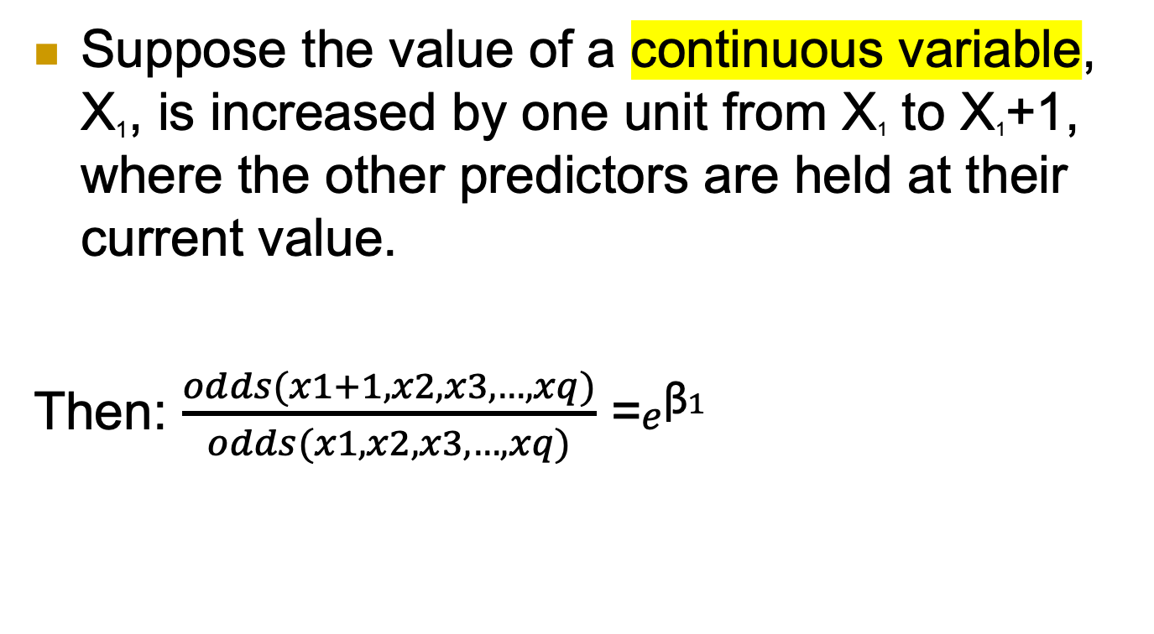
The Odds
Suppose the value of a continuous variable, X₁, is increased by one unit from X₁ to X₁+1, where the other predictors are held at their current value.
Then: $\frac{odds(x1+1, x2, x3,…, xq)}{odds(x1,x2,x3,…,xq)}$ =$e^{ꞵ1}$
Can you prove it?

Slide 40
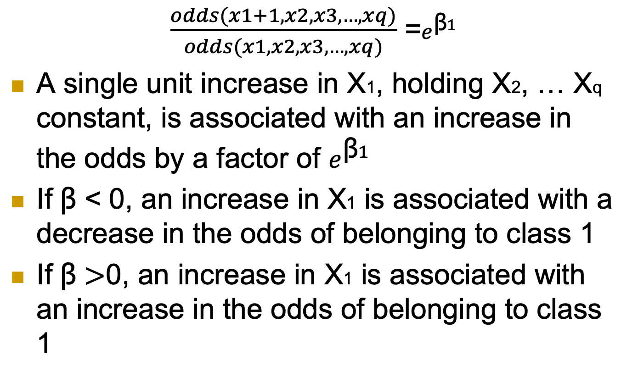
The Odds
$\frac{odds(x1+1, x2, x3,…, xq)}{odds(x1,x2,x3,…,xq)}$ =$e^{ꞵ1}$
A single unit increase in X1, holding X2, … Xq constant, is associated with an increase in the odds by a factor of $e^{ꞵ1}$
If $ꞵ$ < 0, an increase in X1 is associated with a decrease in the odds of belonging to class 1
If $ꞵ>$0, an increase in X1 is associated with an increase in the odds of belonging to class 1

Slide 41
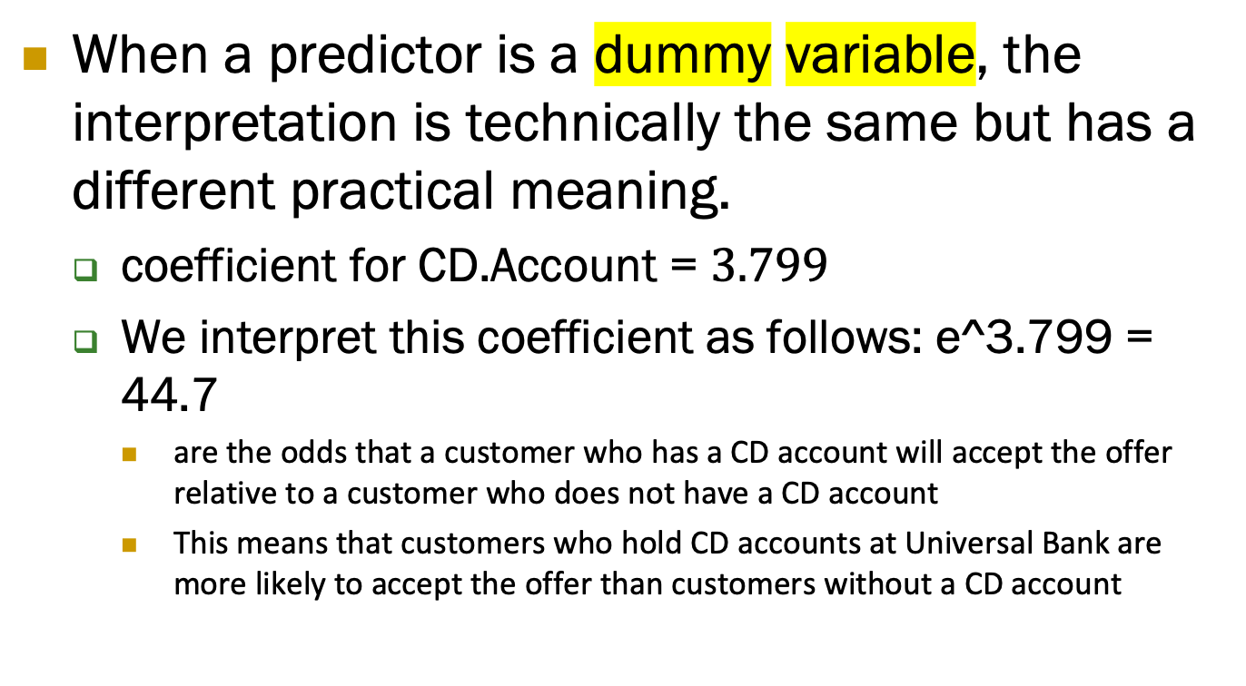
The Odds
When a predictor is a dummy variable, the interpretation is technically the same but has a different practical meaning.
coefficient for CD.Account = $3.799$
We interpret this coefficient as follows: e^3.799 = 44.7
are the odds that a customer who has a CD account will accept the offer relative to a customer who does not have a CD account
This means that customers who hold CD accounts at Universal Bank are more likely to accept the offer than customers without a CD account

Slide 42
Evaluating Classification Performance
Evaluating Classification Performance

Slide 43
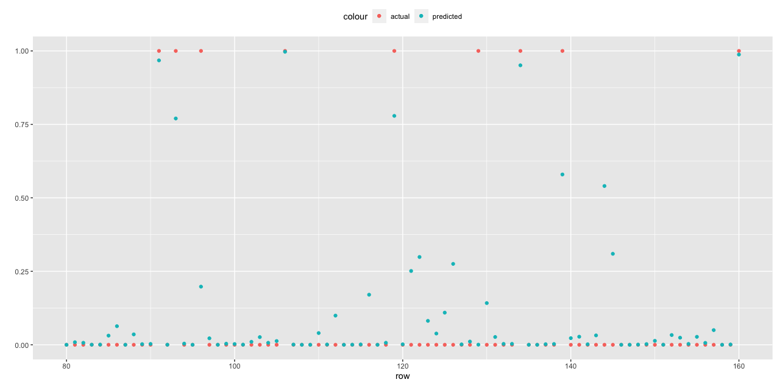
Example, cont.
Compute predicted probabilities for validation set

Slide 44
Performance measures
Confusion matrix
(evaluates model on the whole population)
Lift chart
(evaluates model performance in a portion of the population)

Slide 45
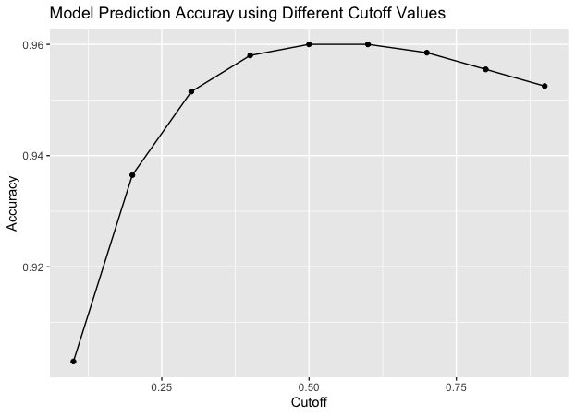
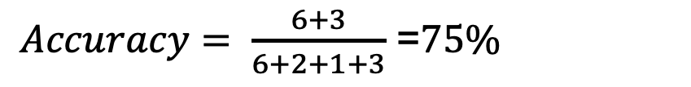
Confusion Matrix
Predicted class Actual class | Class 1 | Class 0
Class 1 | 6 | 2
Class 0 | 1 | 3
$Accuracy= \frac{6+3}{6+2+1+3}$ =$75\%$

Slide 46
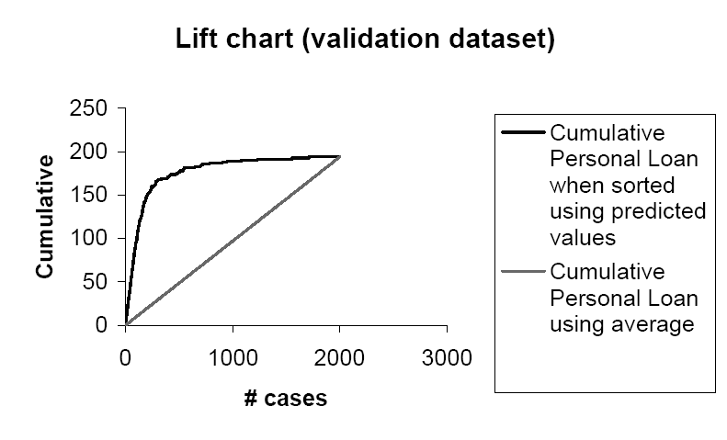
Lift Chart
The “lift” over the base curve indicates for a given number of cases, the additional responders that you can identify by using the model.
The bigger the area between the lift curve and the baseline, the better the model is!

Slide 47
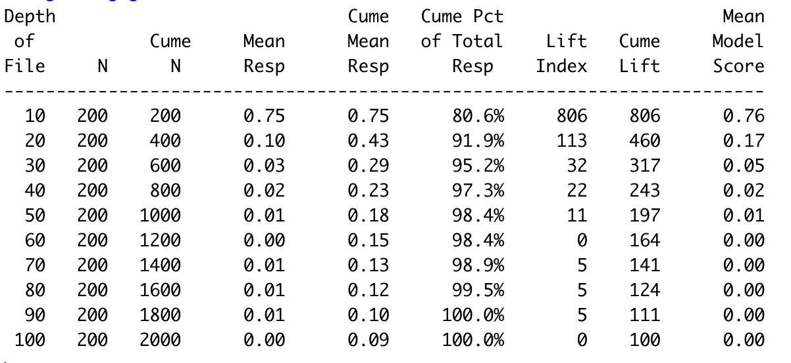
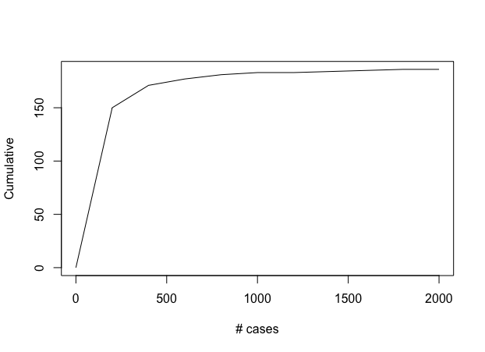
Lift Chart

Slide 48
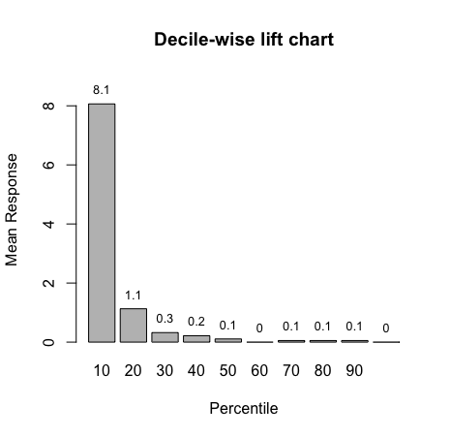
Decile-wise chart
Taking the 10% of the records that are ranked by the model as “most probable 1’s” yields 8.1 times as many 1’s as would simply selecting 10% of the records at random

Slide 49
Variable Selection

Slide 50
Multicollinearity
Problem: As in linear regression, if one predictor is a linear combination of other predictor(s), model estimation will fail
Note that in such a case, we have at least one redundant predictor
Solution: Remove extreme redundancies (by dropping predictors via variable selection – see next, or by data reduction methods such as PCA)
Notes:
50

Slide 51
Variable Selection
This is the same issue as in linear regression
The number of correlated predictors can grow when we create derived variables such as interaction terms (e.g., Income x Family), to capture more complex relationships
Problem: Overly complex models have the danger of overfitting
Solution: Reduce variables via automated selection of variable subsets (as with linear regression)

Slide 52
P-values for Predictors
Test null hypothesis that coefficient = 0
Useful for review to determine whether to include variable in model
Key in profiling tasks, but less important in predictive classification

Slide 53
Variable Selection
This is the same as in linear regression
Use stepwise selection
forward selection, backward, and stepwise (both) elimination In R, use function step()
Try an exhaustive search (if possible)
use R function glmulti() in package glmulti

Slide 54
Summary
Logistic regression is similar to linear regression, except that it is used with a categorical response
It can be used for explanatory tasks (=profiling) or predictive tasks (=classification)
The predictors are related to the response Y via a nonlinear function called the logit
As in linear regression, reducing predictors can be done via variable selection.

